Slide 1
Data Presentation
Marketing Analytics Project

Slide 2
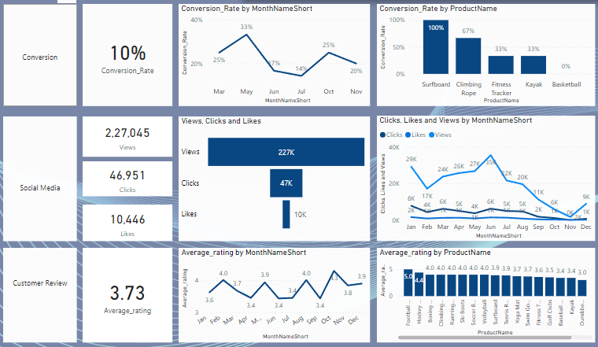
Overview
Decreased Conversion Rates: The conversion rate demonstrated a strong rebound in May, reaching 33%, despite a notable dip to 17% in June.
Reduced Customer Engagement:
There is a decline in overall social media engagement, with views dropping from June to November.
While clicks and likes are low compared to views, while clicks 47k as compared to views 227k shows that engaged users are still interacting effectively.
Customer Feedback Analysis:
Customer rating have remained consistent, averaging around 3.7 throughout the year.
Although stable, the average rating I below the target 4.0, suggesting a need for focused improvements in customer satisfaction, for products below 3.5.

Slide 3
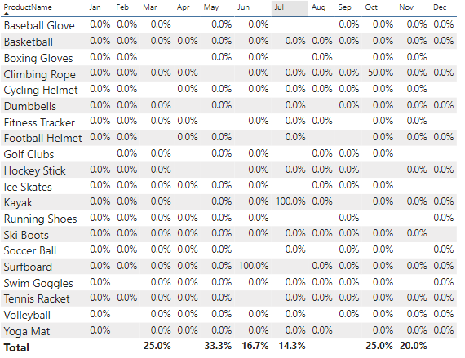
Decreased Conversion Rates
General Conversion Trend:
Throughout the year, conversion rates, with higher numbers converting successfully in months like May and October. This suggest that while some products had strong seasonal peaks, there is potential to improve conversion in lower-performing months through targeted interventions.
Lowest Conversion Month:
July experienced the lowest overall conversion rate at 14.3%. This indicates a potential need to revisit marketing strategies or promotion during period to boost performance.
Highest Conversion Month:
May recorded the highest overall conversion rate at May. This indicate the strong month of the year.

Slide 4
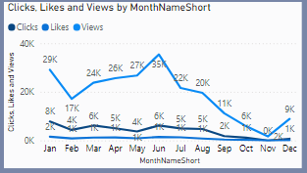
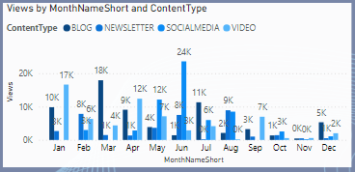
Reduced Customer Engagement
Declining Views:
Views peaked in June but then declined up to November, indicating reduced audience engagement in the later half of year.
Low Interaction Rates:
Clicks and likes remained consistently low compared to views, suggesting the need for more engaging content or stronger calls to action.
Content Type Performance:
Views by content type have better result in June but worst result at November means have to more focus on the content creation.

Slide 5
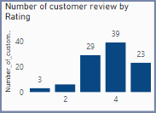
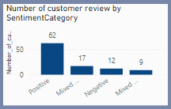
Customer Feedback Analysis
Customer Rating Distribution:
The majority of customer reviews are in the higher ratings, with 39 reviews at 4 stars and 23 reviews at 5 stars, indicating overall positive feedbacks. Lower ratings (1-2 stars) account for small proportion, 3 review with 1 star and 2 review with 2 stars.
Sentiment Analysis:
Positive sentiment dominates with 62 reviews, reflecting a generally satisfied customer base. Negative sentiment with 12 review, with mixed and neutral sentiments, suggesting some areas for improvement but overall strong approval.
Opportunity for improvement:
The presence of mixed positive and negative sentiments indicated that there are opportunities to convert those mixed experiences into more clearly positive ones, potentially boosting overall ratings. Addressing the specific concerns in mixed reviews could elevate customer satisfaction.

Slide 6
Goals & Actions
Goals
Actions
Increase Conversion Rates:
Goal: Identify factors impacting the conversion rate and provide recommendations to improve it.
Insight: Highlight key stages where visitors drop off and suggest improvements to optimize the conversion funnel.
Enhance Customer Engagement:
Goal: Determine which types of content drive the highest engagement.
Insight: Analyze interaction levels with different types of marketing content to inform better content strategies.
Improve Customer Feedback Scores:
Goal: Understand common themes in customer reviews and provide actionable insights.
Insight: Identify recurring positive and negative feedback to guide product and service improvements.
Increase Conversion Rates:
Target High-Performing Product Categories: Focus marketing efforts on products with demonstrated high conversion rates, such as Surfboard and climbing rope. Implement seasonal promotions or personalized campaigns during peak months (e.g., May and October) to capitalize on these trends.
Enhance Customer Engagement:
Revitalize Content Strategy: To turn around declining views and low interaction rates, experiment with more engaging content formats, such as interactive videos or user-generated content. Additionally, boost engagement by optimizing call-to-action placement in social media and blog content, particularly during historically lower-engagement months (September-December).
Improve Customer Feedback Scores:
Address Mixed and Negative Feedback: Implement a feedback loop where mixed and negative reviews are analyzed to identify common issues. Develop improvement plans to address these concerns. Consider following up with dissatisfied customers to resolve issues and encourage re-rating, aiming to move average ratings closer to the 4.0 target.

